Slide 1
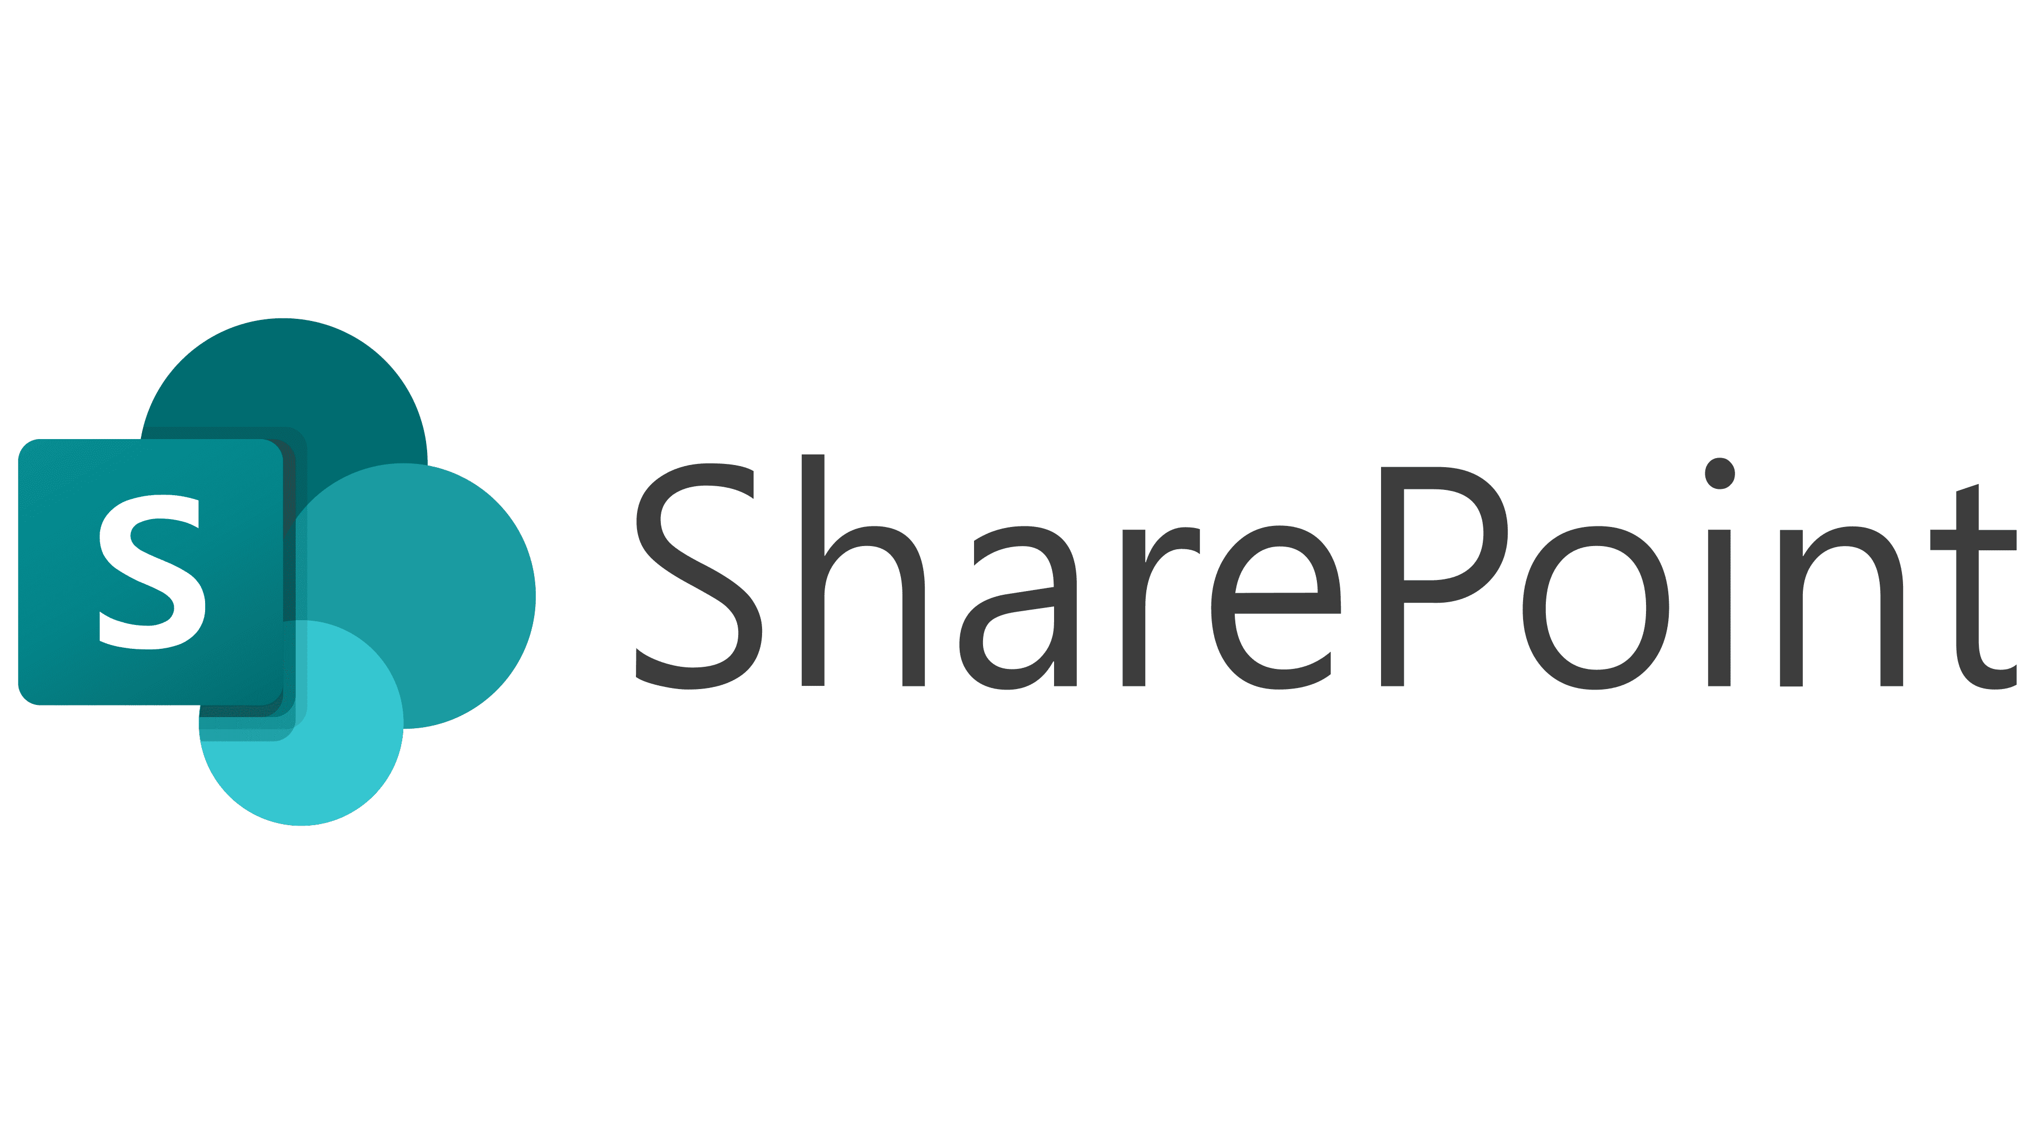
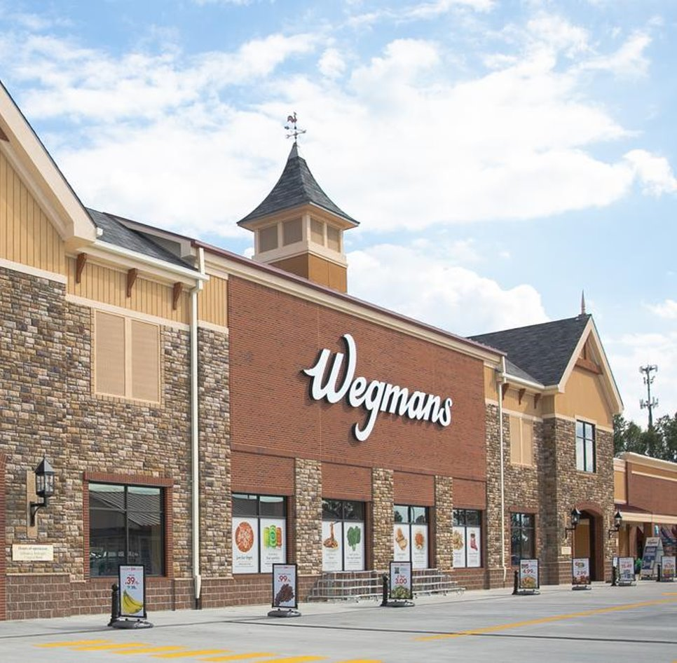
Wegmans SharePoint Migration
Business Need
Wegman’s, a 110-store supermarket chain, needed to modernize their enterprise SharePoint intranet to improve employee communication, streamline workflows, and support long-term scalability. Their existing environment required a full UX/UI refresh, updated custom applications, optimized processes, and a move to SharePoint Online to better support their 55,000 employees.
What We Did
Redesigned the intranet’s UX/UI to create a modern, intuitive experience
Refactored legacy workflows and custom applications for improved performance
Migrated the full intranet environment to SharePoint Online
Implemented updated navigation, content architecture, and design standards
Conducted end-to-end testing and coordinated the enterprise-wide launch
Established an ongoing managed service program for M365, SharePoint, and Power Platform support
Results
Successfully launched a modern SharePoint Online intranet to 55,000 employees
Improved usability, accessibility, and navigation across the digital workplace
Reduced operational friction by modernizing custom workflows and applications
Increased platform stability and scalability through migration to the cloud
Provided continuous enhancement and support through a multi-year managed services partnership

Slide 2
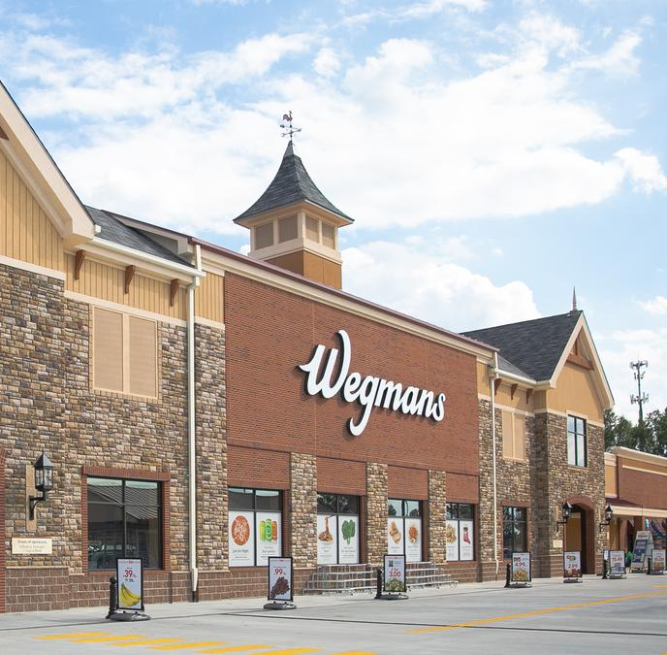
Wegman’s - SharePoint Redesign, Migration & Managed Service
Background
Wegmans, a 110-store supermarket chain came to Affirma for support in redesigning and modernizing their enterprise SharePoint intranet. This included a full UX/UI redesign, refactoring of custom applications and workflows, and a migration to SharePoint Online.
Affirma partnered with Wegman’s to execute the project on time and on budget, successfully launching the redesigned environment to their 55,000 employees.
Managed Service
Affirma has continued supporting Wegman’s for several years as their ongoing managed service provider across M365, SharePoint, and Power Platform administration and development.

